Slide 1





Defining Classes
Classes, Fields, Constructors, Methods, Properties
SoftUni Team
Technical Trainers
Software University
http://softuni.bg

Slide 2

Table of Contents
Defining Simple Classes
Fields
Access Modifiers
Using Classes and Objects
Constructors
Methods
Properties
Keeping the Object State

Slide 3
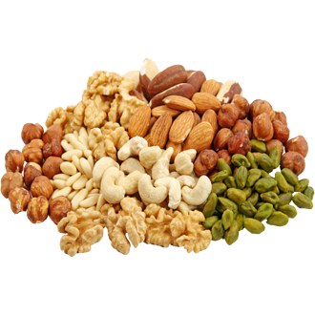
Defining Simple Classes

Slide 4
Classes in OOP
Classes model real-world objects and define:
Attributes (state, properties, fields)
Behavior (methods, operations)
Classes describe the structure of objects
Objects describe particular instance of a class
Properties hold information about the modeled object relevant to the problem
Operations implement object behavior

Slide 5
Classes in C#
Classes in C# can have members:
Fields, constants, methods, properties, indexers, events, operators, constructors, destructors, …
Inner types (inner classes, structures, interfaces, delegates, ...)
Members can have access modifiers (scope)
public, private, protected, internal
Members can be
static (common) or specific for a given object (per instance)

Slide 6

Simple Class Definition
Beginning of class definition
public class Cat : Animal {
private string name;
public Cat(string name, string owner)
{
this.Name = name;
this.Owner = owner;
}
public string Name
{
get { return this.name; }
set { this.name = value; }
}
Inherited (base) class
Field
Constructor
Property

Slide 7
Simple Class Definition (2)
public string Owner
{
get;
set;
}
public void SayMiau()
{
Console.WriteLine("Miauuuuuuu!");
}
}
Automatic Property
Method
End of class definition

Slide 8
Class Definition and Members
Class definition consists of:
Class declaration
Inherited class and implemented interfaces
Fields (static or not)
Constructors (static or not)
Properties (static or not)
Methods (static or not)
Events, inner types, etc.

Slide 9

Fields
Data Fields
Defining and Using Data Fields

Slide 10
Fields
Fields are data members defined inside a class
Fields hold the internal object state
Can be static or per instance
Can be private / public / protected / …
class Dog
{
private string name;
private string breed;
private int age;
protected Color color;
}
Field declarations

Slide 11
Constant Fields
Constant fields are of two types:
Compile-time constants – const
Replaced by their value during the compilation
Runtime constants – readonly
Assigned once only at object creation
class Math
{
public const float PI = 3.14159;
public readonly Color = Color.FromRGBA(25, 33, 74, 128);
}

Slide 12
Constant Fields – Example
public class Constants
{
public const double PI = 3.1415926535897932385;
public readonly double Size;
public Constants(int size)
{
this.Size = size; // Cannot be further modified!
}
static void Main()
{
Console.WriteLine(Constants.PI);
Constants c = new Constants(5);
Console.WriteLine(c.Size);
c.Size = 10; // Compilation error: readonly field
Console.WriteLine(Constants.Size); // Compilation error: non-static field
}
}

Slide 13


Access Modifiers
public, private, protected, internal

Slide 14
Access Modifiers
Class members can have access modifiers
Used to restrict the access from the other classes
Supports the OOP principle "encapsulation"
Class members can be:
public – accessible from any class
protected – accessible from the class itself and all its descendants
private – accessible from the class itself only
internal (default) – accessible from the current assembly, i.e. the current Visual Studio project

Slide 15
The "this" Keyword
The keyword this points to the current instance of the class
Example:
class Dog
{
private string name;
public void PrintName()
{
Console.WriteLine(this.name);
// The same like Console.WriteLine(name);
}
}

Slide 16

Exercise in Class

Slide 17
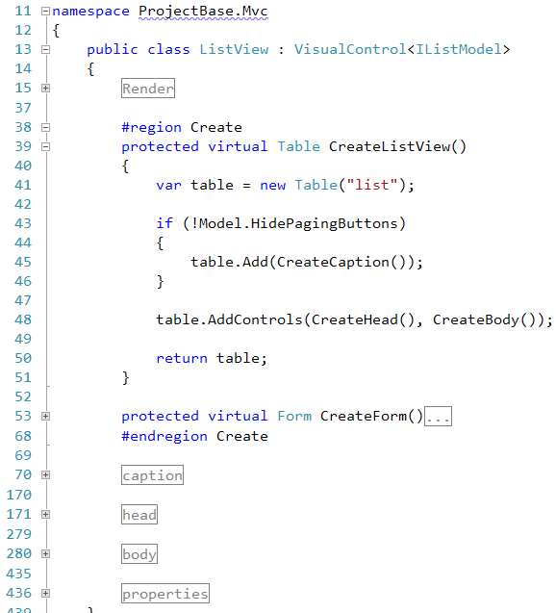

Using Classes and Objects

Slide 18


How to Use Classes (Non-Static)?
Create an instance
Initialize its properties / fields
Manipulate the instance
Read / modify its properties
Invoke methods
Handle events
Release the occupied resources
Performed automatically in most cases

Slide 19
Dog Meeting – Example
static void Main()
{
Console.Write("Enter first dog's name: ");
string dogName = Console.ReadLine();
Console.Write("Enter first dog's breed: ");
string dogBreed = Console.ReadLine();
// Use the Dog constructor to assign name and breed
Dog firstDog = new Dog(dogName, dogBreed);
// Use Dog's parameterless constructor
Dog secondDog = new Dog();
// Use properties to assign name and breed
Console.Write("Enter second dog's name: ");
secondDog.Name = Console.ReadLine();
Console.Write("Enter second dog's breed: ");
secondDog.Breed = Console.ReadLine(); (the example continues)

Slide 20
Dog Meeting – Example (2)
// Create a Dog with no name and breed
Dog thirdDog = new Dog();
// Save the dogs in an array
Dog[] dogs = new Dog[] { firstDog, secondDog, thirdDog };
// Ask each of the dogs to bark
foreach (Dog dog in dogs)
{
dog.SayBau();
}
}

Slide 21

Dog Meeting
Live Demo

Slide 22

Constructors
Defining and Using Class Constructors

Slide 23
What is Constructor?
Constructors are special methods
Invoked at the time of creating a new instance of an object
Used to initialize the fields of the instance
Constructors have the same name as the class
Have no return type
Can have parameters
Can be private, protected, internal, public

Slide 24

Defining Constructors
Class Point with parameterless constructor:
public class Point
{
private int xCoord;
private int yCoord;
// Simple parameterless constructor
public Point()
{
this.xCoord = 0;
this.yCoord = 0;
}
// More code …
}

Slide 25
Defining Constructors (2)
public class Person
{
private string name;
private int age;
// Parameterless constructor
public Person()
{
this.name = null;
this.age = 0;
}
// Constructor with parameters
public Person(string name, int age)
{
this.name = name;
this.age = age;
}
// More code …
}
As a rule constructors should initialize all class fields

Slide 26
Constructors and Initialization
Pay attention when using inline initialization!
public class AlarmClock
{
private int hours = 9; // Inline initialization
private int minutes = 0; // Inline initialization
// Parameterless constructor (intentionally left empty)
public AlarmClock()
{ }
// Constructor with parameters
public AlarmClock(int hours, int minutes)
{
this.hours = hours; // Invoked after the inline
this.minutes = minutes; // initialization!
}
// More code …
}

Slide 27

Chaining Constructors Calls
Reusing the constructors (chaining)
public class Point
{
private int xCoord;
private int yCoord;
public Point() : this(0, 0) // Reuse the constructor
{
}
public Point(int xCoord, int yCoord)
{
this.xCoord = xCoord;
this.yCoord = yCoord;
}
// More code …
}

Slide 28

Constructors
Live Demo

Slide 29
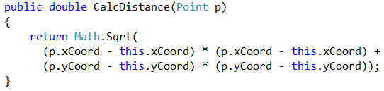


Methods
Defining and Invoking Methods

Slide 30
Methods
Methods execute some action (some code / some algorithm)
Could be static / per instance
Could be public / private / protected / …
public class Point
{
private int xCoord;
private int yCoord;
public double CalcDistance(Point p)
{
return Math.Sqrt(
(p.xCoord - this.xCoord) * (p.xCoord - this.xCoord) +
(p.yCoord - this.yCoord) * (p.yCoord - this.yCoord));
}
}

Slide 31
Using Methods
Invoking instance methods is done through the object (through the class instance):
class TestMethods
{
static void Main()
{
Point p1 = new Point(2, 3);
Point p2 = new Point(3, 4);
System.Console.WriteLine(p1.CalcDistance(p2));
}
}

Slide 32
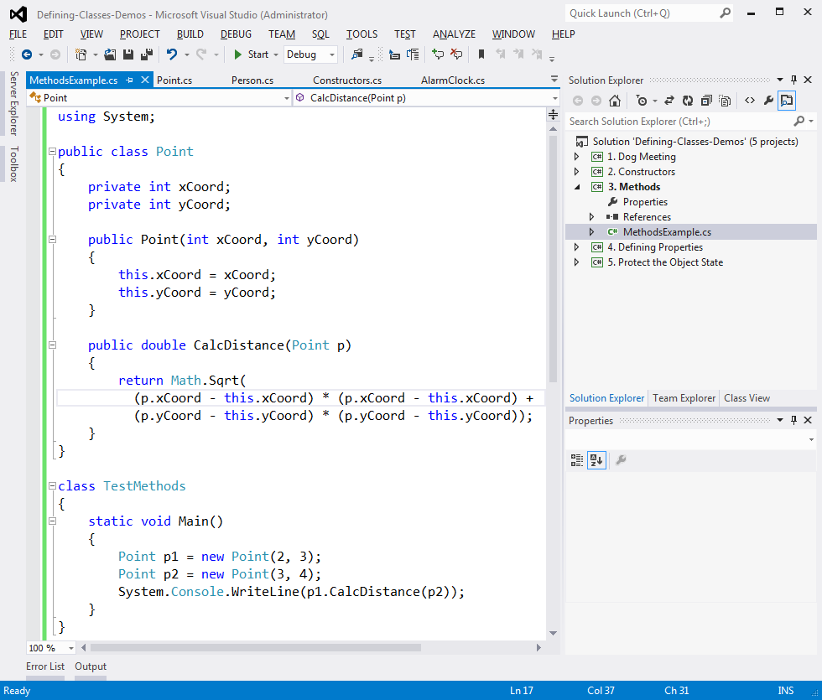
Methods
Live Demo

Slide 33
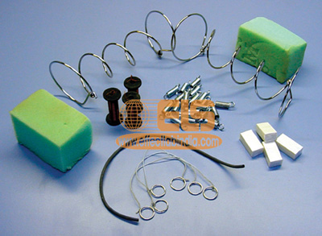
Properties
Defining and Using Properties

Slide 34

Why We Need Properties?
Properties expose object's data to the world
Control how the data is accessed / manipulated
Ensure the internal object state is correct
E.g. price should always be kept positive
Properties can be:
Read-only
Write-only
Read and write

Slide 35
Defining Properties
Properties work as a pair of get / set methods
Getter and setter
Properties should have:
Access modifier (public, protected, etc.)
Return type
Unique name
Get and / or Set part
Can process data in specific way, e.g. apply validation

Slide 36
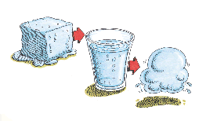
Defining Properties – Example
public class Point
{
private int xCoord;
private int yCoord;
public int XCoord
{
get { return this.xCoord; }
set { this.xCoord = value; }
}
public int YCoord
{
get { return this.yCoord; }
set { this.yCoord = value; }
}
// More code …
}

Slide 37
Dynamic Properties
Properties are not always bound to a class field
Can be dynamically calculated:
public class Rectangle
{
private double width;
private double height;
public double Area
{
get
{
return width * height;
}
}
}

Slide 38
Automatic Properties
Properties could be defined without an underlying field
They are automatically created by the compiler (auto properties)
class UserProfile
{
public int UserId { get; set; }
public string FirstName { get; set; }
public string LastName { get; set; }
}
…
UserProfile profile = new UserProfile() {
FirstName = "Steve",
LastName = "Balmer",
UserId = 91112
};

Slide 39

Properties
Live Demo

Slide 40




Keeping the Object State Correct

Slide 41
Keep the Object State Correct
Constructors and properties can keep the object's state correct
This is known as encapsulation in OOP
Can force validation when creating / modifying the object's internal state
Constructors define which properties are mandatory and which are optional
Property setters should validate the new value before saving it in the object field
Invalid values should cause an exception

Slide 42
Keep the Object State – Example
public class Person
{
private string name;
public Person(string name)
{
this.Name = name;
}
public string Name
{
get { return this.name; }
set
{
if (string.IsNullOrEmpty(value))
throw new ArgumentException("Invalid name!");
this.name = value;
}
}
}
We have only one constructor, so we cannot create a person without specifying a name
Incorrect name cannot be assigned

Slide 43
Keeping the Object State Correct
Live Demo

Slide 44

Summary
Classes define specific structure for objects
Objects are particular instances of a class
Classes define fields, methods, constructors, properties and other members
Access modifiers limit the access to class members
Constructors are invoked when creating new class instances and initialize the object's internal state
Properties expose the class data in safe, controlled way

Slide 45

License
This course (slides, examples, demos, videos, homework, etc.) is licensed under the "Creative Commons Attribution-NonCommercial-ShareAlike 4.0 International" license
Attribution: this work may contain portions from
"Fundamentals of Computer Programming with C#" book by Svetlin Nakov & Co. under CC-BY-SA license
"OOP" course by Telerik Academy under CC-BY-NC-SA license

Slide 46









Defining Classes
https://softuni.bg/courses/oop

Slide 47





Free Trainings @ Software University
Software University Foundation – softuni.org
Software University – High-Quality Education, Profession and Job for Software Developers
softuni.bg
Software University @ Facebook
facebook.com/SoftwareUniversity
Software University @ YouTube
youtube.com/SoftwareUniversity
Software University Forums – forum.softuni.bg

